Slide 1
Flood Plain 101
What Every Bidder Should Know Before Bidding on a Property in the Flood Plain
Shawn Sturhan
Assistant Manager
Harris County Permits Office
Shawn.Sturhan@hcpid.org

Slide 2
TOPICS
How to determine floodplain status of a property;
What jurisdiction the property lies within;
Floodplain management rules for unincorporated Harris County.
Harris County Permits Office
http://www.eng.hctx.net/permits

Slide 3
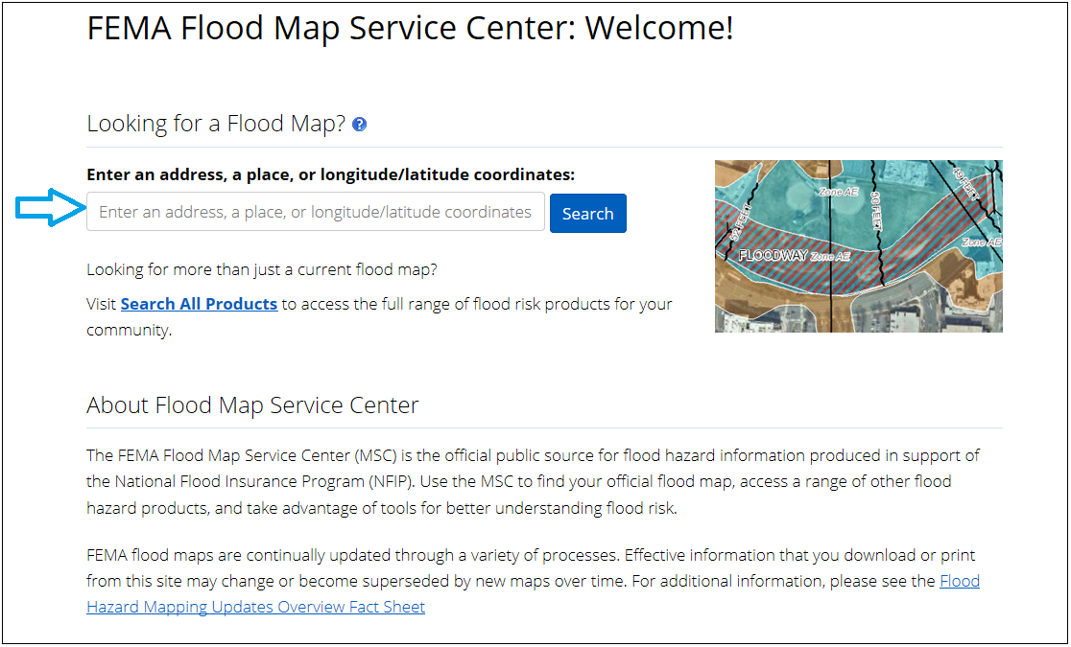
Flood Plain Status
FEMA Flood Map Service Center(top link if you Google ‘FEMA flood maps’)
https://msc.fema.gov/portal/home

Slide 4
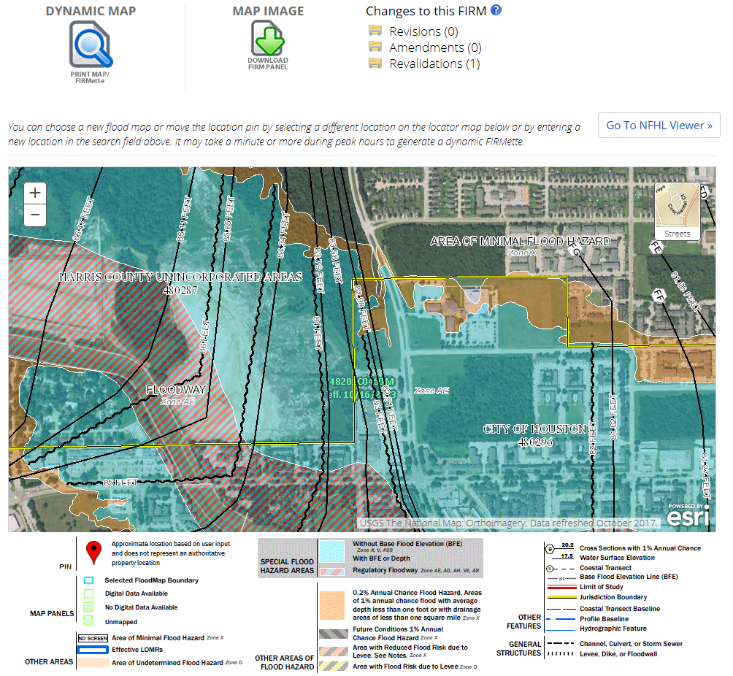

Slide 5
Jurisdiction
Incorporated vs Unincorporated: who is the floodplain administrator?
Incorporated means a tract that lies within the boundaries of a city, ie…Houston, Jersey Village, Pasadena, etc. That city would be the Floodplain Administrator and issue all permits. Thus, their floodplain requirements must be met.
Unincorporated means any tract that lies within Harris County but outside the boundaries of any city. Harris County would be the Floodplain Administrator and issue all permits. Thus, Harris County’s floodplain requirements must be met.

Slide 6
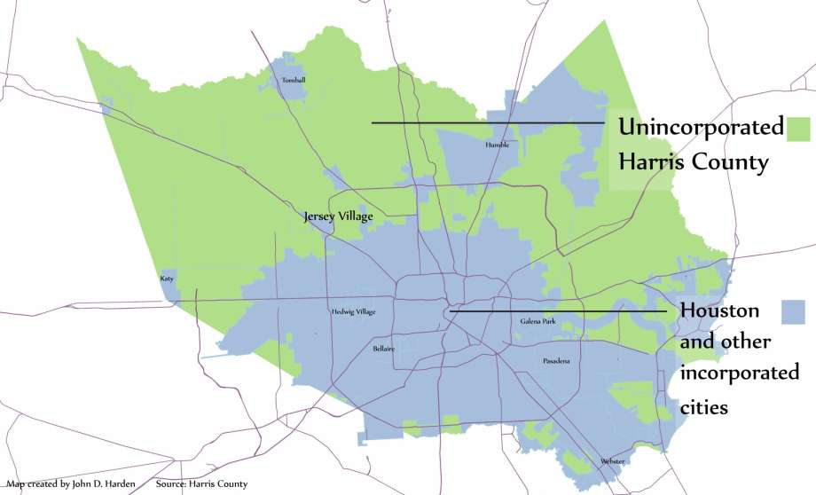

Slide 7
Harris County Floodplain Regulations

Slide 8
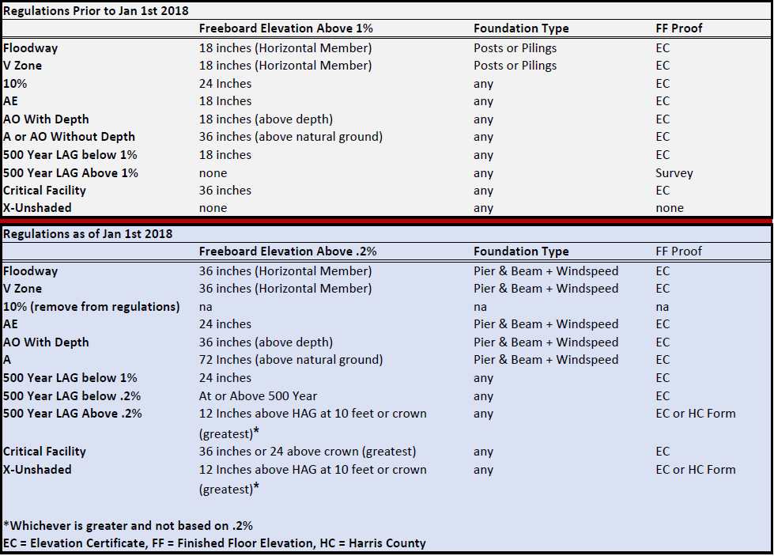

Slide 9
No Net Fill - Any reduction in flood plain storage or conveyance capacity within the 1 percent or 100-year flood plain must be offset with a hydraulically equivalent (one-to-one) volume of mitigation sufficient to offset the reduction. The reduction may result from development or the placement of fill within the 1% flood plain or 100-year flood plain.
Pier and Beam - No fill may be used to elevate structures in the 1 percent or 100-year flood plain. Structures may be constructed on an open foundation, such as piers, or on continuous foundation walls with properly sized and located openings.

Slide 10
Floodway Requirements
The bottom of the lowest horizontal sill, beam or member supporting the structure in the floodway shall be at least thirty-six (36) inches above the 0.2 percent or 500-year flood elevation.
A hydraulic analysis of pre- and proposed development conditions showing that no increase in the elevation of the base flood will occur as a result of the development
The minimum embedment below natural grade for driven piles and drilled piers shall be twenty (20) feet
Driven piles shall consist of either twelve (12) inch (minimum) square pre-stressed concrete piles or fourteen (14) inch (minimum) diameter steel pipe piles with a closed end.
Additional construction requirements

Slide 11
Questions?
Shawn Sturhan, P.E.
Assistant Manager
Harris County Permits Office
713-274-3753
Shawn.Sturhan@hcpid.org

